Slide 1



EDU4clima
Learning and Educating about Climate Change

Slide 2

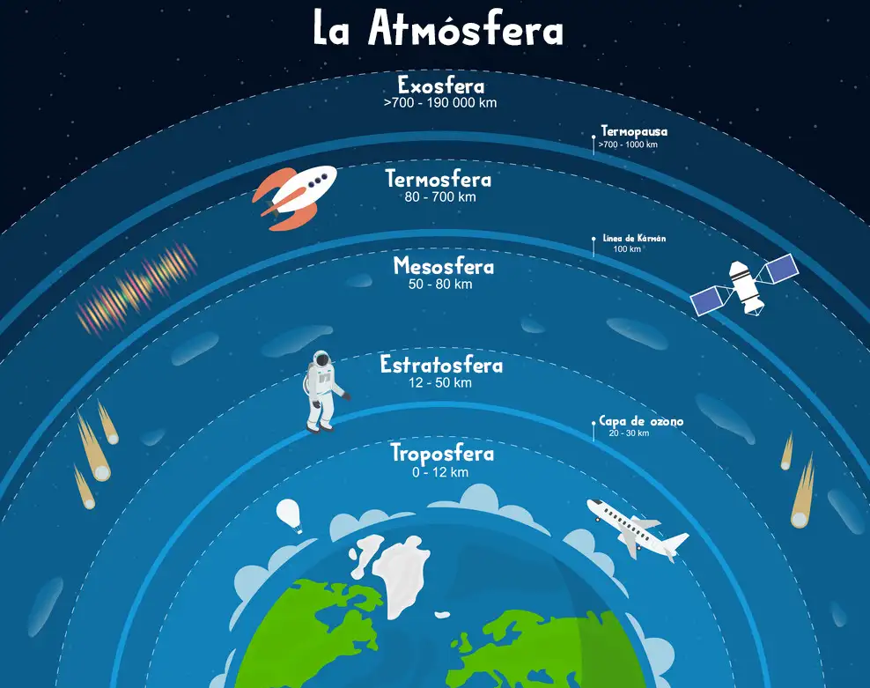
EDU4clima
THE ATMOSPHERE
Exosphere
Thermopause
Thermosphere
Karman line
Mesosphere
Stratosphere
Ozon layer
Troposphere

Slide 3
EDU4clima
COMPSITION OF THE ATMOSPHERE
Constituent | Content in mole fraction
Nitrogen (N₂) | 0.7808 (75.51% of the total mass)
Oxygen (O₂) | 0.2095 (23.14% of the total mass)
Argon (Ar) | 0.0093 (1.28% of the total mass)
Water Vapor (H₂O) | 0-0.04
Carbon dioxide (CO₂) | 420 parts per million
Νeon (Ne) | 18 parts per million
Helium (He) | 5 parts per million
Krypton (Kr) | 1 parts per million
Hydrogen (H₂) | 0.5 parts per million
Ozon (O₃) | 0-12 parts per million
The atmosphere also contains aerosols and water

Slide 4
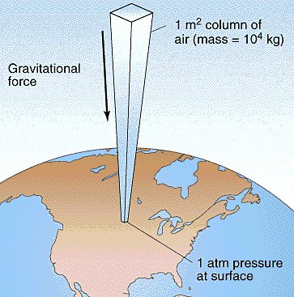
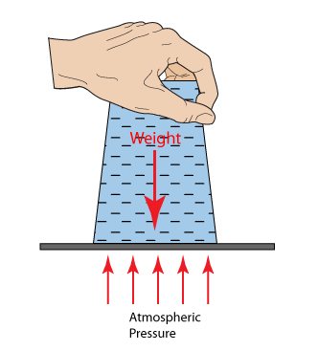
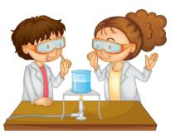
EDU4clima
The atmosphere is not void!
Weight of water
Atmospheric pressure
http://peter-mulroy.squarespace.com/air-pressure/
https://ylikonet.gr/
The atmosphere has substantial mass and consists of a wide variety of components

Slide 5
Question 1:
What will happen if you turn a glass of water upside down?
Why?

Slide 6
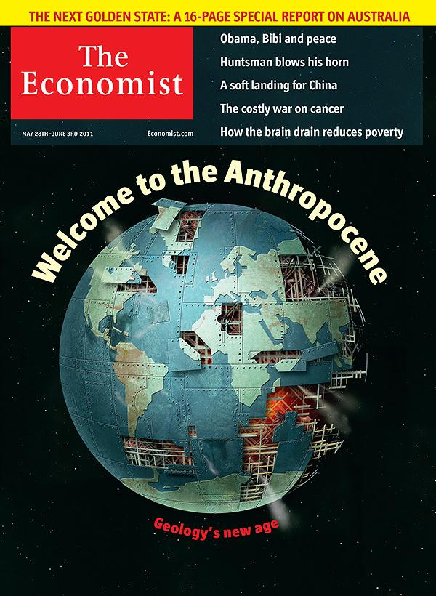

EDU4clima
Can its composition change?
The composition of the atmosphere is in a dynamic state due to the biological and geological interaction with the Earth, human activities and chemical reactions between its components.
The Human Epoch (or Anthropocene) is a proposed geological era dating from the onset of major human impacts on Earth's geology and ecosystems, including but not limited to anthropogenic climate change
Notes:
Understand the Earth System

Slide 7
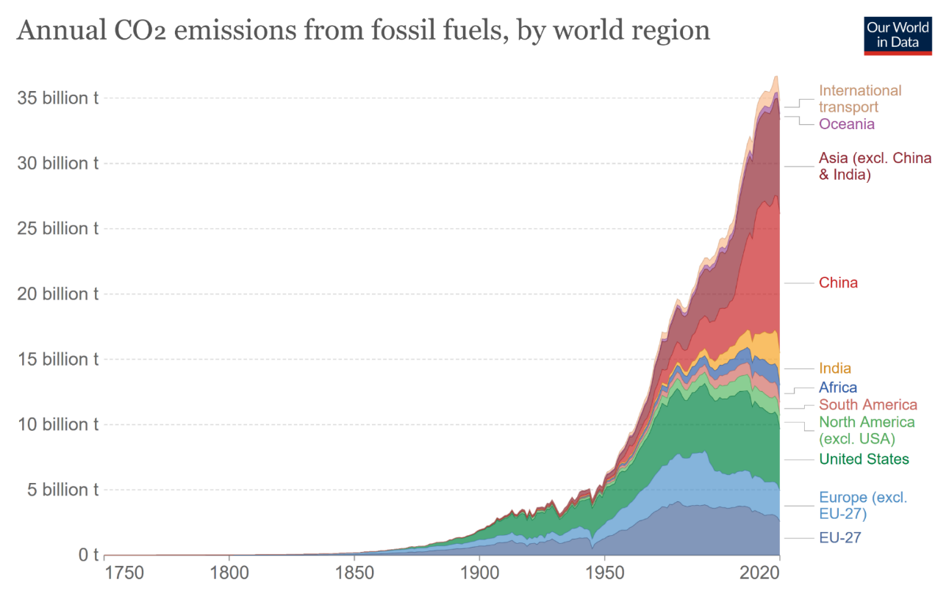
EDU4clima
Can its composition change?
Since the industrial revolution, huge amounts of pollutants such as CO₂ have been emitted into the atmosphere and continue to be emitted with unabated intensity.

Slide 8
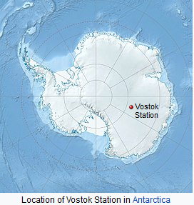
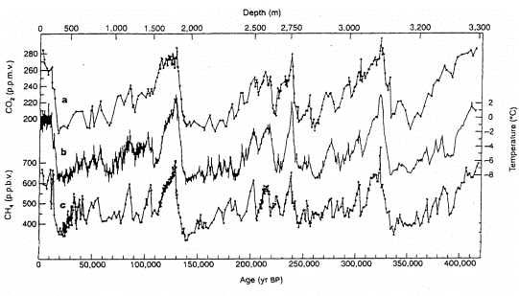
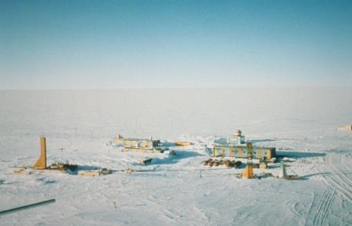
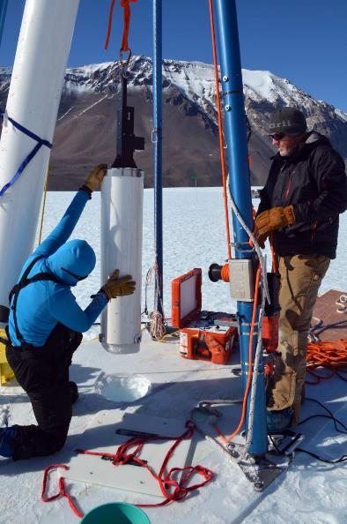
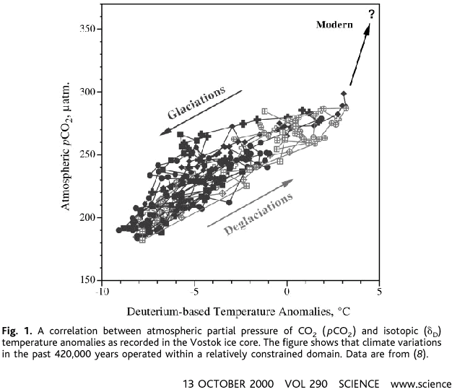
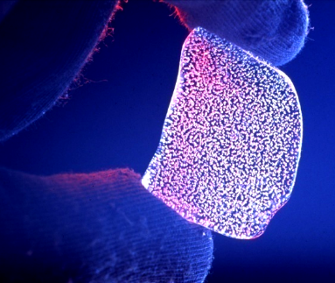
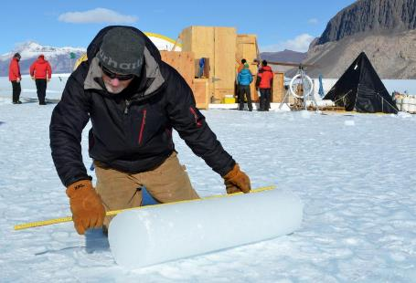
Physical changes of CO₂, CH₄ & Temperature
Measurements in ice cores
EDU4clima
CO₂
ΔΤ
CH₄
Glaciations
Atmospheric CO₂ in μatm
Deglaciations –
Ice melting
Temperature change ^{ο}C
images from wikipedia

Slide 9
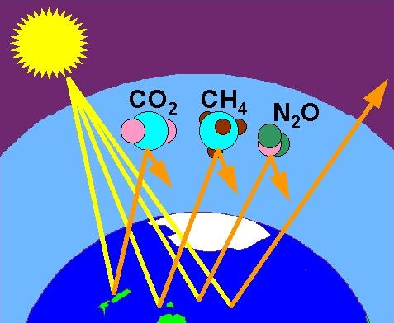
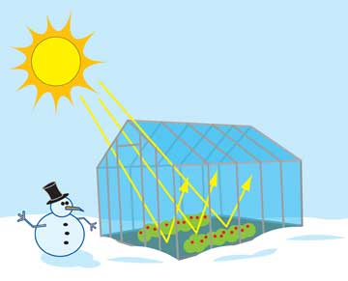
Climate & greenhouse gases
EDU4clima
The sun is a source of heating for the Earth.
Without the atmosphere the Earth's temperature would be -18 ºC.
The warming of the atmosphere by naturally originated greenhouse gases increases the temperature by about 33 ºC i.e. to about 15 ºC.

Slide 10
Question 2:
What do you think is the effect of the increase in the concentration of CO₂ on the temperature of the atmosphere?

Slide 11
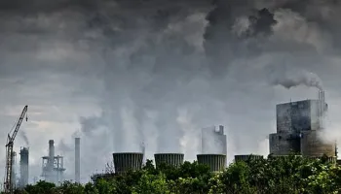
EDU4clima
Air pollution
Air pollution is not only about the gases that cause the greenhouse effect but also about a variety of gaseous and particulate pollutants.
Notes:
11

Slide 12
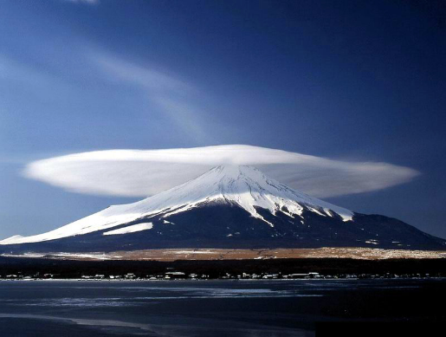
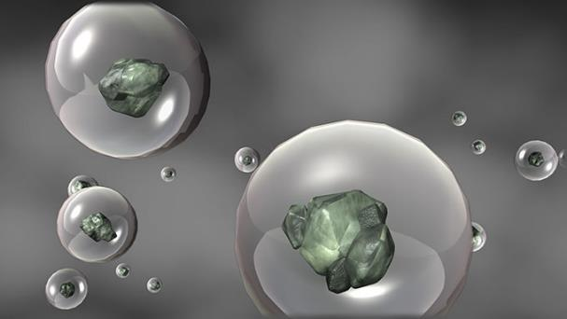
EDU4clima
Hydrological cycle
Aerosols participate in the formation of clouds and the determination of precipitation –that is why they are called Cloud Condensation Nuclei
Air pollution also affects the climate in terms of the water cycle
Currently, there is a lot of uncertainty on how anthropogenic changes in clouds affect the climate

Slide 13
Question 3:
What is the role of aerosols (e.g. smoke) in cloud formation?

Slide 14
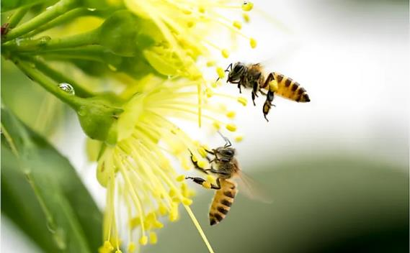
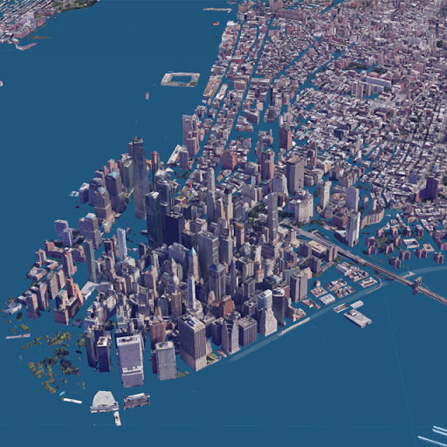
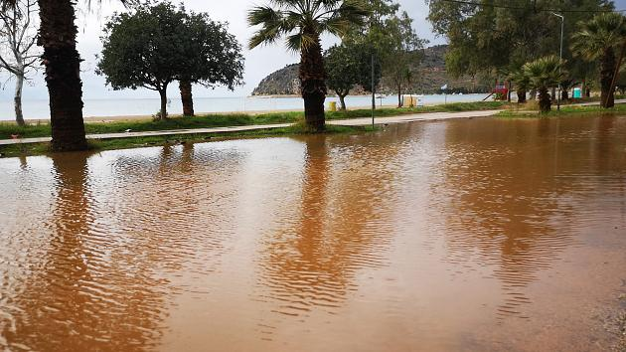

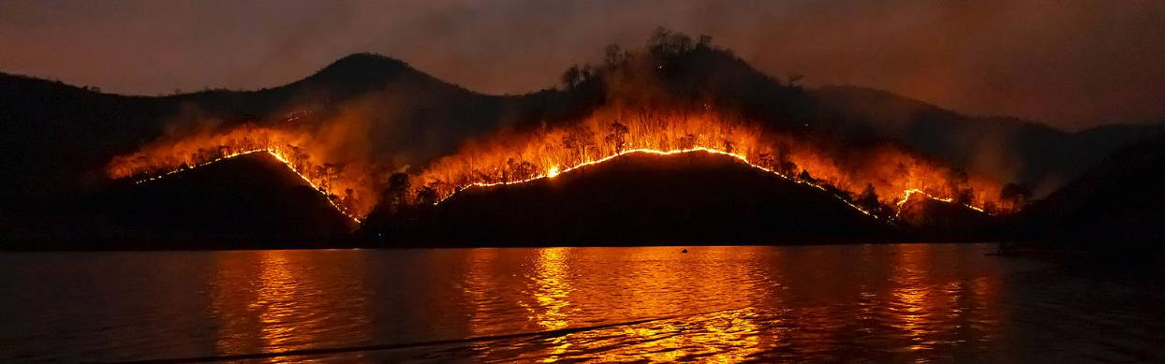
EDU4clima
Climate change impacts
Biodiversity
Floods
SEA LEVEL RISE
ECONOMY
WILDFIRES

Slide 15
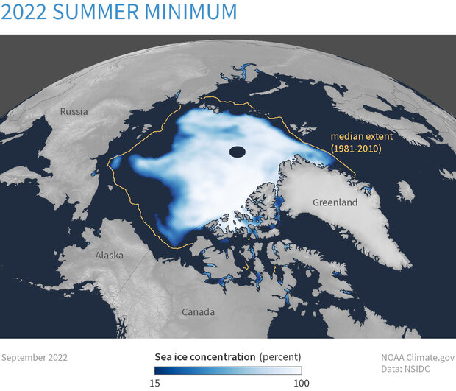
EDU4clima
Ice melting
A direct result of global warming is the melting of ice

Slide 16
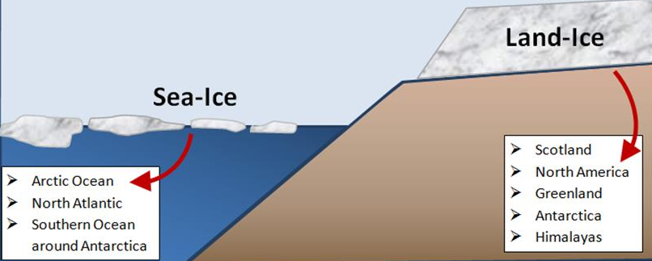
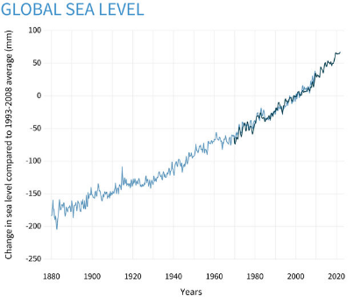
EDU4clima
Ice melting
Land – Ice
Sea Ice
Does it contribute to the level rise?
Does it contribute to the level rise?
Does melting of sea ice contribute to sea level rise?
Will melting of land ice lead to sea level rise?

Slide 17
Question 4:
Is sea level rise caused primarily by the melting of land or sea ice?

Slide 18
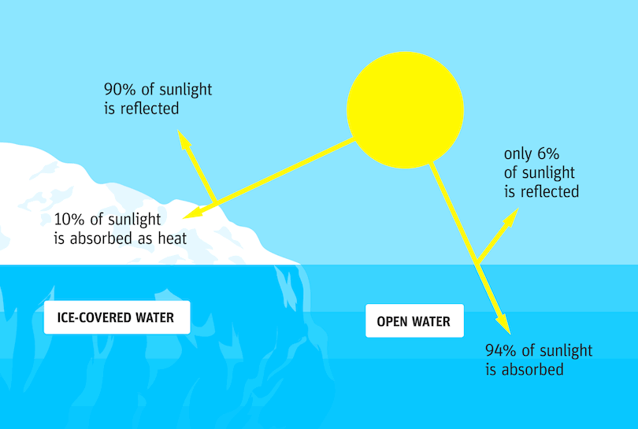
EDU4clima
Albedo
90% of sunlight is reflected
Only 6% of sunlight is reflected
10% of sunlight is absorbed as heat
ICE-COVERED WATER
Water
without ice
94% of sunlight is absorbed
Melting of sea ice affects the reflectivity of the oceans

Slide 19
Question 5:
What are the consequences of the decrease in the reflectivity of the polar ice caps on the planet’s temperature?

Slide 20

EDU4clima
Climate change and oceans
The world's oceans are extremely vulnerable to climate change

Slide 21

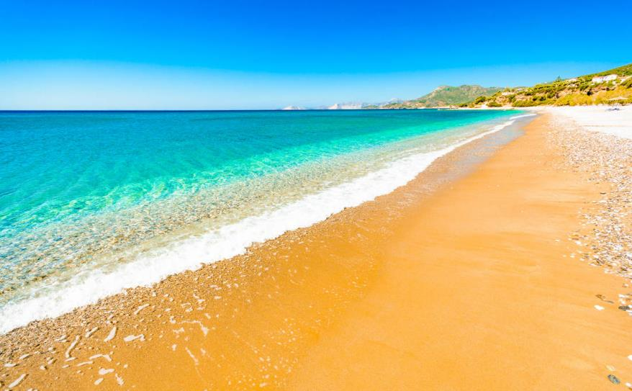

EDU4clima
Heat Capacity of Water
Water can absorb hundreds of times more heat than the atmosphere

Slide 22
Question 6:
Can oceans store heat?

Slide 23

EDU4clima
Ocean currents
Can melting of ice and warming of the oceans alter marine circulation?

Slide 24
Question 7:
Can melting of ice caps and warming of the oceans alter marine circulation?

Slide 25
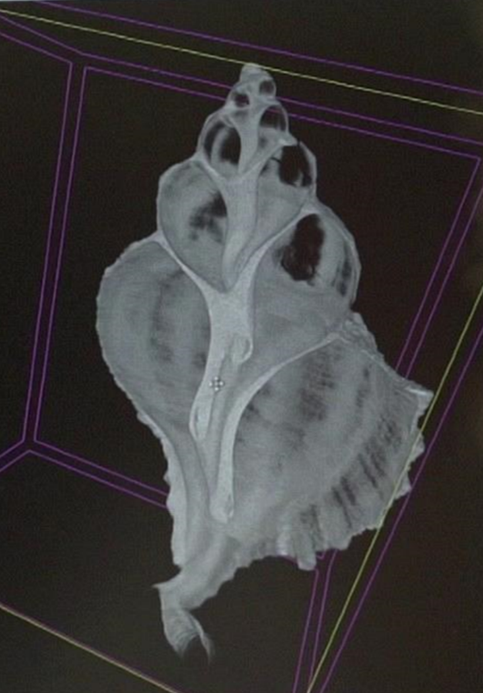
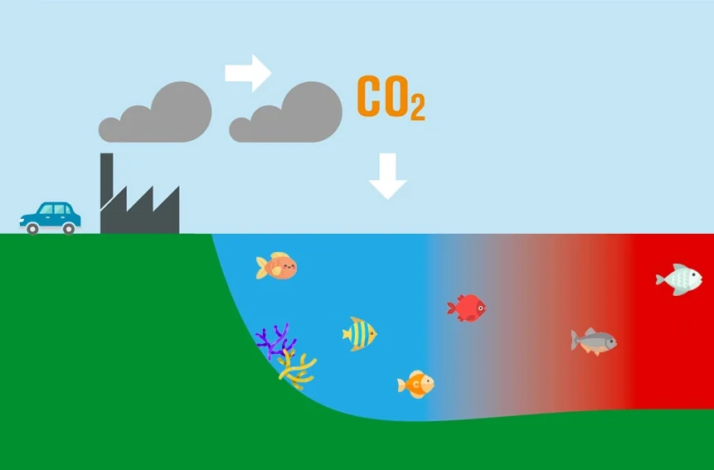
EDU4clima
Ocean acidification
CO₂ reacts with water molecules to form carbonic acid, lowering the pH of the oceans making them more acidic.

Slide 26
Question 8:
If carbon dioxide dissolves in water, will the acidity of the water change?

